Slide 1
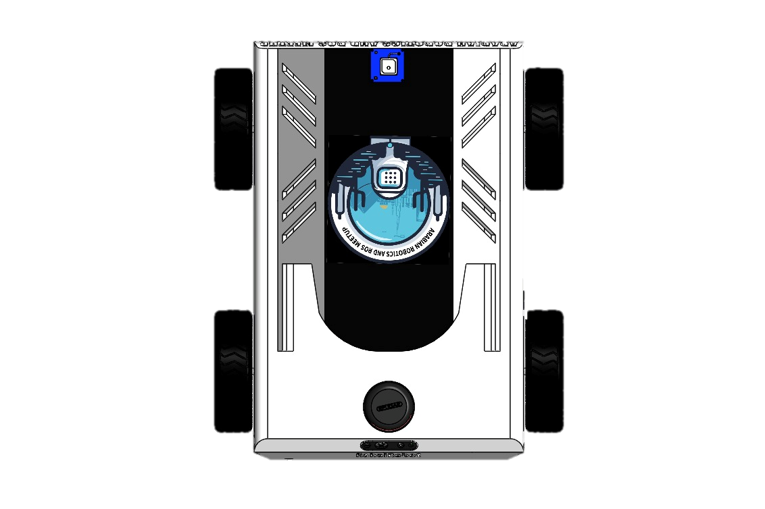

Slide 33

1st Loop Closure

Slide 49
After Multiple Loop Closure

